Slide 1

MECHANICAL ENGINEERING SCIENCE (UE23ME131A)
Srinivasa Prasad K S
Department of Mechanical Engineering

Slide 2
MECHANICAL ENGINEERING SCIENCE
Unit2
Srinivasa Prasad K S
Department of Mechanical Engineering

Slide 3
MECHANICAL ENGINEERING SCIENCE
Chapter 1 – Engineering Materials
Srinivasa Prasad K S
Department of Mechanical Engineering

Slide 4
MECHANICAL ENGINEERING SCIENCE
ENGINEERING MATERIALS
INTRODUCTION TO ENGINEERING MATERIALS
Engineering materials are defined as substances which are manufactured and used for various engineering applications.
Why do we study materials?
An applied scientist or engineer, whether mechanical, civil, chemical, or electrical, will at one time or another be exposed to a design problem involving materials. Examples might include a transmission gear, the superstructure for a building, an oil refinery component, or an integrated circuit chip.
Often a materials problem is really one of selecting the material that has the right combination of characteristics for a specific application. The selection will be usually based on in – service conditions, any deterioration of material properties that may occur during service operation, consideration of cost etc.
The more familiar an engineer or scientist is with the various characteristics and structure–property relationships, as well as processing techniques of materials, the more proficient and confident he or she will be to make judicious materials choices based on these criteria.

Slide 5
MECHANICAL ENGINEERING SCIENCE
ENGINEERING MATERIALS
CLASSIFICATION OF MATERIALS
Solid materials have been conveniently grouped into three basic classifications:
metals, ceramics, and polymers.
This scheme is based primarily on chemical makeup and atomic structure, and most materials fall into one distinct grouping or another, although there are some intermediates.
In addition, there are the composites, combinations of two or more of the above three basic material classes.
Another classification is advanced materials—those used in high-technology applications—viz. semiconductors, biomaterials, smart materials, and nano engineered materials.

Slide 6
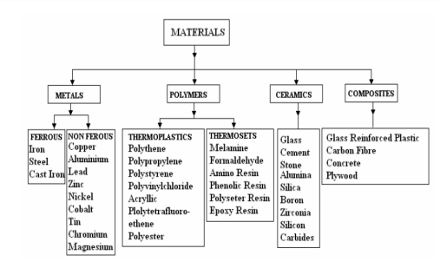
MECHANICAL ENGINEERING SCIENCE
ENGINEERING MATERIALS

Slide 7
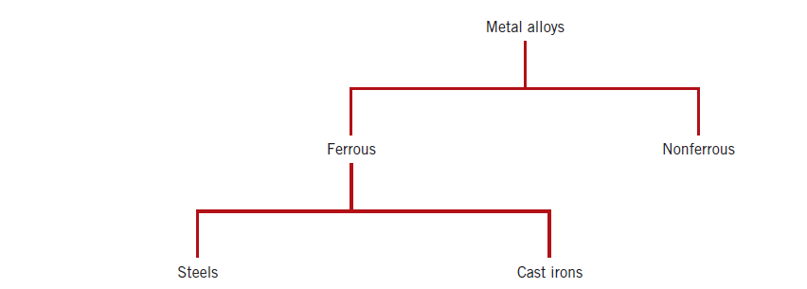
MECHANICAL ENGINEERING SCIENCE
ENGINEERING MATERIALS
METAL ALLOYS
Metal alloys, by virtue of composition, are often grouped into two classes—ferrous and nonferrous.
Ferrous alloys, those in which iron is the principal constituent, include steels and cast irons.
The nonferrous ones—all alloys that are not iron based.

Slide 8
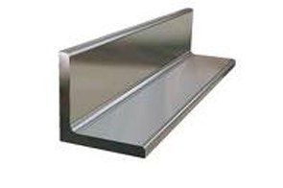
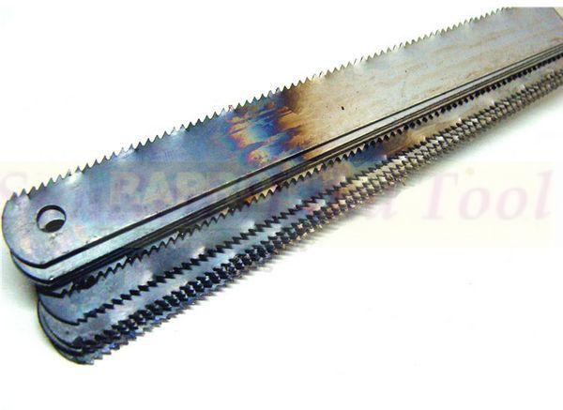
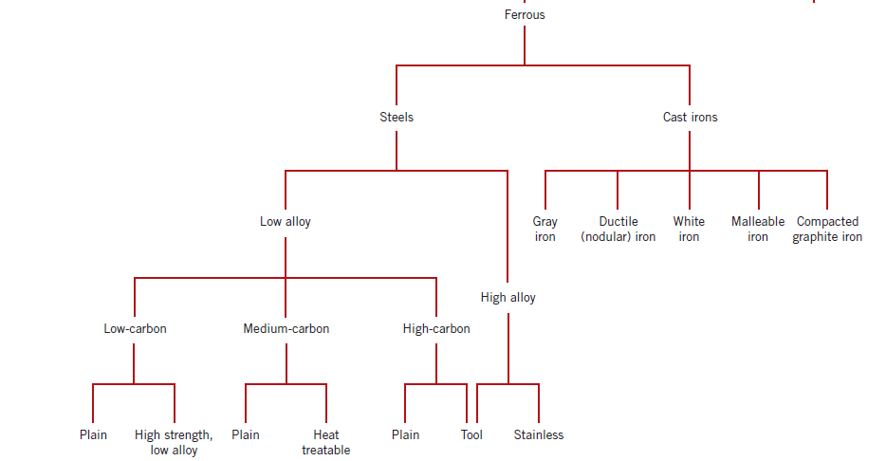
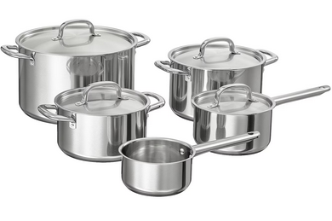
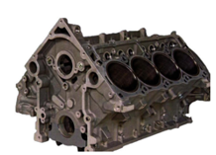
MECHANICAL ENGINEERING SCIENCE
ENGINEERING MATERIALS
FERROUS ALLOYS

Slide 9
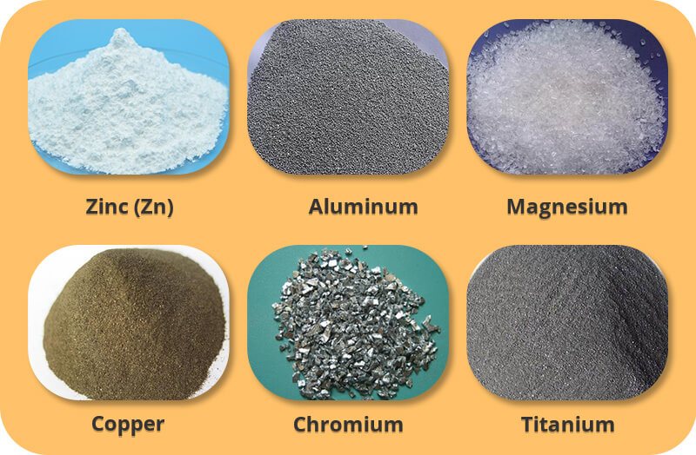
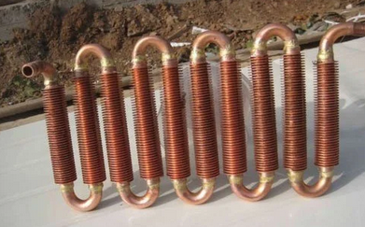
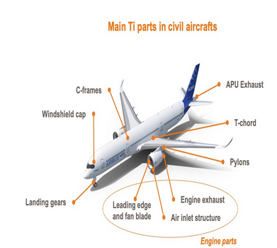
MECHANICAL ENGINEERING SCIENCE
ENGINEERING MATERIALS
NON FERROUS ALLOYS
Steel and other ferrous alloys are consumed in exceedingly large quantities because they have such a wide range of mechanical properties, may be fabricated with relative ease, and are economical to produce.
However, they have some distinct limitations, chiefly:
(1) a relatively high density,
(2) a comparatively low electrical conductivity, and
(3) an inherent susceptibility to corrosion in some common
environments.
Thus, for many applications it is advantageous or even necessary to utilize other alloys having more suitable property combinations.

Slide 10
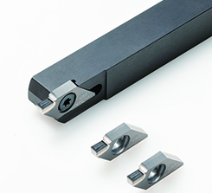

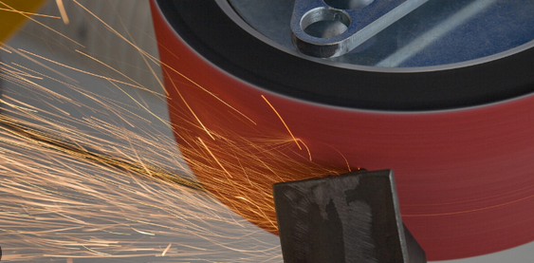
MECHANICAL ENGINEERING SCIENCE
ENGINEERING MATERIALS
CERAMICS AND PLASTICS
Ceramics can be defined as a compound of metallic and non – metallic elements with predominantly ‘ionic’ interatomic bonding.
Some of their examples are Magnesia (MgO), Alumina (Al₂O₃), Zirconia (ZrO₂), Beryllia (BeO), Silicon Carbide (SiC) and Tungsten Carbide (TiC).
Typical applications - ceramic substrates for electronic devices, turbocharger rotors, aerospace turbine blades, nuclear fuel rods, lightweight armour, cutting tools, abrasives, thermal barriers and furnace/kiln furniture.

Slide 11
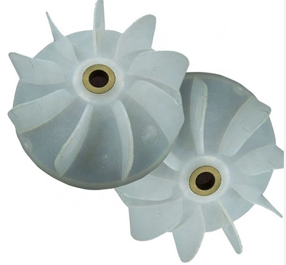
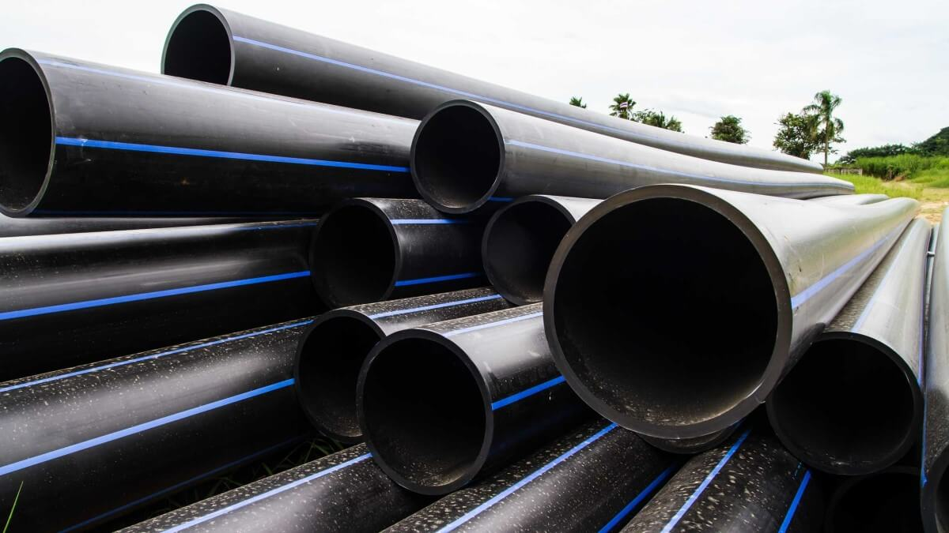
MECHANICAL ENGINEERING SCIENCE
ENGINEERING MATERIALS
CERAMICS AND PLASTICS
A plastic can be defined as a solid material consisting of an organic polymer of a long molecular chain and high molecular weight.
Plastics are divided into two basic groups depending on their behaviour at elevated temperatures, viz., thermoplastics and thermosetting plastics.
Typical applications –
Polyamide (Nylon etc.) – gears, bearing, conveyor rollers,
cooling fans
Polyethylene (Polythene) – gaskets, washers, pipes
Polytetrafluoroethylene (Teflon) – self lubricating bearing
Phenolic – clutch and brake linings

Slide 12
MECHANICAL ENGINEERING SCIENCE
ENGINEERING MATERIALS
COMPOSITES
A composite is a structural material that consists of two or more combined constituents that are combined at a macroscopic level and are not soluble in each other.
One constituent is called the reinforcing phase and the one in which it is embedded is called the matrix. The reinforcing phase material may be in the form of fibers, particles, or flakes. The matrix phase materials are generally continuous.
Examples of composite systems include concrete reinforced with steel and epoxy reinforced with graphite fibers, etc.
Some examples of naturally found composites - wood, where the lignin matrix is reinforced with cellulose fibers and bones in which the bone-salt plates made of calcium and phosphate ions reinforce soft collagen.

Slide 13
MECHANICAL ENGINEERING SCIENCE
ENGINEERING MATERIALS
COMPOSITES
The advantages of using composites over metals -
Monolithic metals and their alloys cannot always meet the demands of today’s advanced technologies. Only by combining several materials can one meet the performance requirements.
For example, trusses and benches used in satellites need to be dimensionally stable in space during temperature changes between –256°F (–160°C) and 200°F (93.3°C). Limitations on coefficient of thermal expansion thus are low and may be of the order of ±1.8×10⁻⁷ m/m/°C. Monolithic materials cannot meet these requirements; this leaves composites, such as graphite/epoxy, as the only materials to satisfy them.
In many cases, using composites is more efficient. For example, in the highly competitive airline market, one is continuously looking for ways to lower the overall mass of the aircraft without decreasing the stiffness and strength of its components. This is possible by replacing conventional metal alloys with composite materials.

Slide 14
MECHANICAL ENGINEERING SCIENCE
ENGINEERING MATERIALS
COMPOSITES
Even if the composite material costs may be higher, the reduction in the number of parts in an assembly and the savings in fuel costs make them more profitable. Reducing one lbm (0.453 kg) of mass in a commercial aircraft can save up to 360 gal (1360 l) of fuel per year; fuel expenses are 25% of the total operating costs of a commercial airline.
Composites offer several other advantages over conventional materials. These may include
improved strength,
improved stiffness,
improved fatigue and impact resistance,
improved thermal conductivity,
improved corrosion resistance etc.

Slide 15
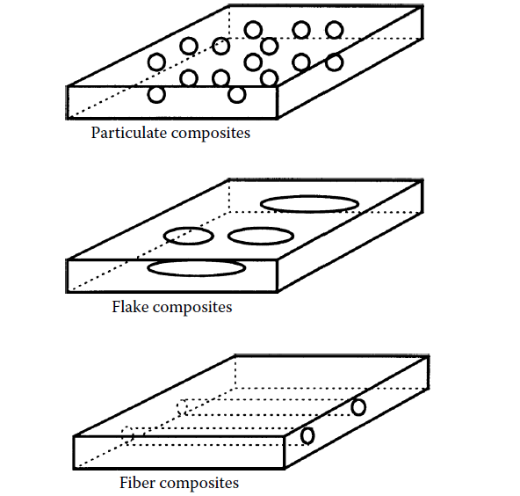
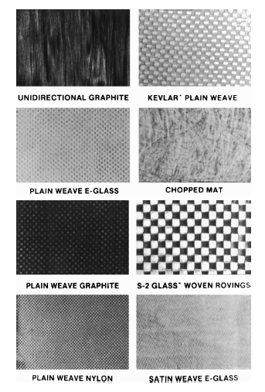
MECHANICAL ENGINEERING SCIENCE
ENGINEERING MATERIALS
COMPOSITES
Classification of composites
Composites are classified by the geometry of the reinforcement — particulate, flake, and fibers — or by the type of matrix — polymer, metal, ceramic, and carbon.

Slide 16
MECHANICAL ENGINEERING SCIENCE
ENGINEERING MATERIALS
COMPOSITES
Examples –
Particulate composites - aluminum particles in rubber; silicon carbide particles in aluminum; and gravel, sand, and cement to make concrete
Fiber reinforced composites - Fibers are generally anisotropic and examples include carbon and aramids. Examples of matrices are resins such as epoxy, metals such as aluminum, and ceramics such as calcium–alumino silicate.
Polymer matrix composites – It consists of a polymer (e.g., epoxy, polyester, urethane) reinforced by thin diameter fibers (e.g., graphite, aramids, boron). For example, graphite/ epoxy composites are approximately five times stronger than steel on a weight for weight basis.
Metal matrix composites - Examples of matrices in such composites include aluminum, magnesium,
and titanium. Typical fibers include carbon and silicon carbide.
Ceramic matrix composites - Ceramic matrix composites (CMCs) have a ceramic matrix such as alumina
calcium alumino silicate reinforced by fibers such as carbon or silicon carbide.

Slide 17
MECHANICAL ENGINEERING SCIENCE
ENGINEERING MATERIALS
COMPOSITES
Applications –
Aircraft - Use of composites is limited to secondary structures such as rudders and elevators made of graphite/epoxy for the Boeing 767 and landing gear doors made of Kevlar–graphite/epoxy. Composites are also used in panels and floorings of airplanes.
Sporting goods - Graphite/epoxy is replacing metals in golf club shafts mainly to decrease the weight and use the saved weight in the head. Tennis and racquetball rackets with graphite/epoxy frames are now commonplace.
Medical devices - Applications here include the use of glass–Kevlar/epoxy lightweight face masks for epileptic patients. Artificial portable lungs are made of graphite–glass/epoxy so that a patient can be mobile.
Automobile - The fiberglass body of the Corvette comes to mind when considering automotive applications of composites. In addition, the Corvette has glass/epoxy composite leaf springs with a fatigue life of more than five times that of steel.

Slide 18
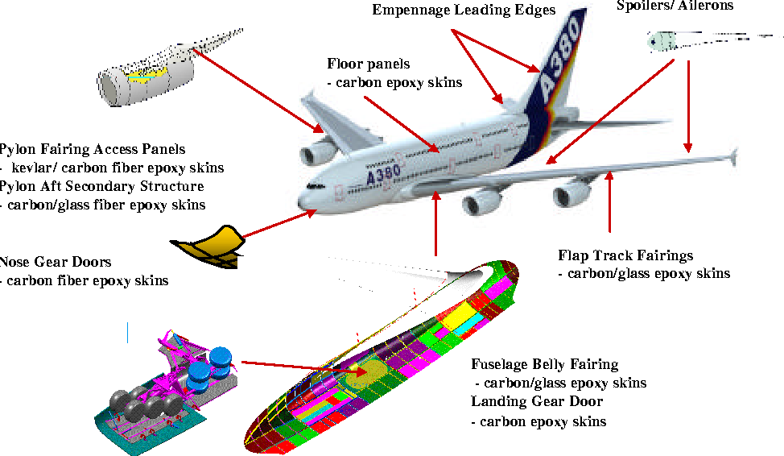
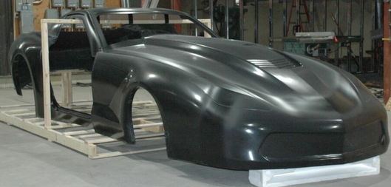
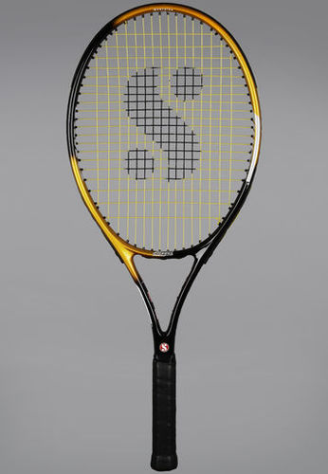
MECHANICAL ENGINEERING SCIENCE
ENGINEERING MATERIALS
COMPOSITES
Cynergy C7 Z06 Corvette Fiberglass body
Composite materials in Airbus A - 380
Graphite/Epoxy tennis racket

Slide 19
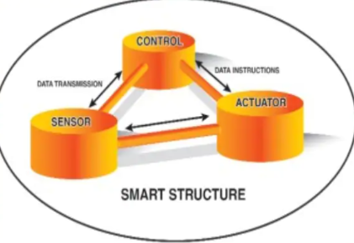
MECHANICAL ENGINEERING SCIENCE
ENGINEERING MATERIALS
SMART MATERIALS
Smart materials are materials that have to respond to stimuli and environmental changes and to activate their functions according to these changes.
The stimuli like temperature, pressure, electric flow, magnetic flow, light, mechanical etc. can originate internally or externally.
A smart system/ structure involves actuators and sensors, one or microprocessors that analyse the responses from the sensors and use integrated control theory to command the actuators to apply localised action to alter system response.
Key elements of smart system/structure-
Sensor
Actuator
Control System
Power and Signal Conditioning Electronics
Computer

Slide 20
MECHANICAL ENGINEERING SCIENCE
ENGINEERING MATERIALS
SMART MATERIALS
Types -
Piezoelectric Materials
Shape Memory Alloys
Electrostrictive Materials
Magnetostrictive Materials
Rheological Fluids
Thermoresponsive Materials
Electrochromic Materials etc.

Slide 21
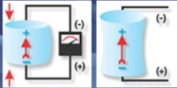

MECHANICAL ENGINEERING SCIENCE
ENGINEERING MATERIALS
PIEZOELECTRIC MATERIALS
Piezoelectricity is a phenomenon that occurs in certain class of anisotropic crystals subjected to change in mechanical deformation.
By applying mechanical deformations to these crystals, electric dipoles are generated and potential difference develops that is contingent upon the changing deformations – Direct effect
By applying potential difference across the crystal, mechanical deformations are also generated – converse effect.
Commercially available industrial piezoelectric materials are piezoceramics such as Lead Zirconate Titanate (PZT) ad piezopolymers such as polyvinylidene fluoride
Applications – Voltage and power sources, sensors, actuators, piezoelectric motors, active vibration control, surgery etc.

Slide 22
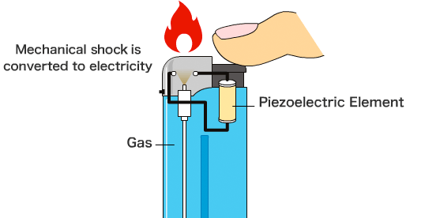
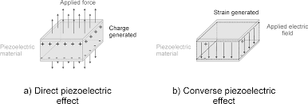
MECHANICAL ENGINEERING SCIENCE
ENGINEERING MATERIALS

Slide 23
MECHANICAL ENGINEERING SCIENCE
ENGINEERING MATERIALS
SHAPE MEMORY ALLOYS
Certain classes of metallic alloys have a special ability to ‘memorize’ their shape at a low temperature, and recover large deformations imparted at a low temperature on thermal activation. These alloys are called Shape Memory Alloys (SMA).
The recovery of strains imparted to the material at a lower temperature, as a result of heating, is called the Shape Memory Effect (SME).
Shape Memory Effect
One way Shape Memory Effect
Two way Shape Memory Effect

Slide 24
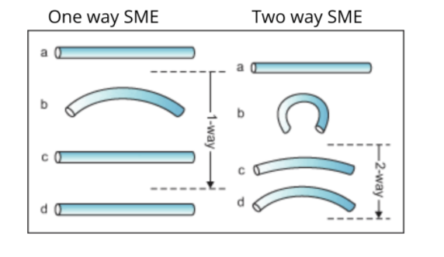
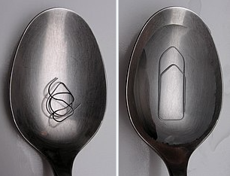
MECHANICAL ENGINEERING SCIENCE
ENGINEERING MATERIALS
SHAPE MEMORY ALLOYS

Slide 25
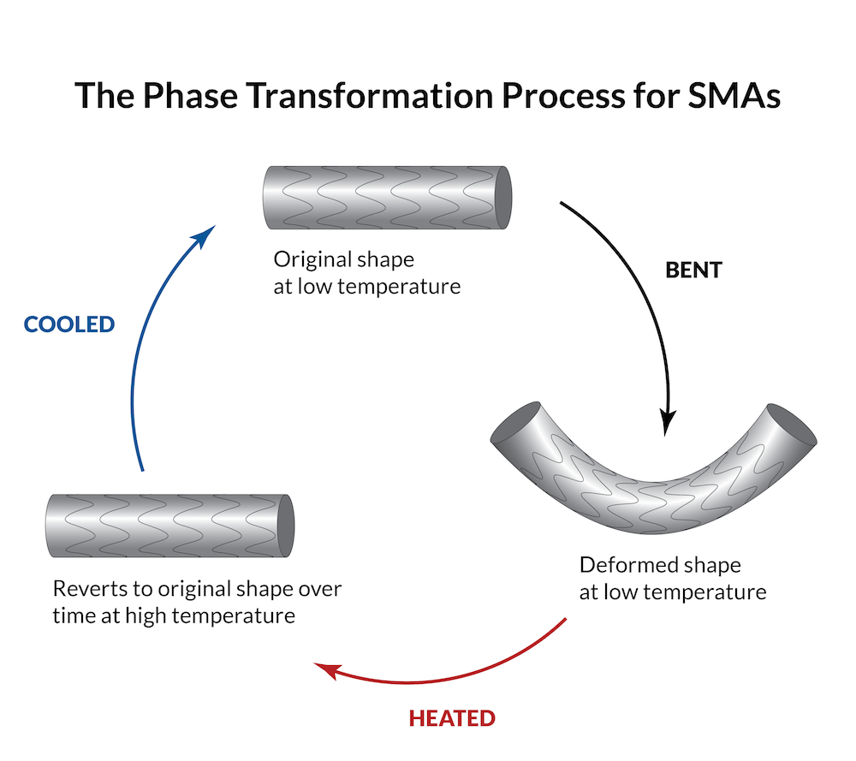
MECHANICAL ENGINEERING SCIENCE
ENGINEERING MATERIALS

Slide 26
MECHANICAL ENGINEERING SCIENCE
ENGINEERING MATERIALS
SHAPE MEMORY ALLOYS
One way Shape Memory Effect –
A deformation imparted to the material in the low temperature martensite phase is fully recovered upon heating as the material completely transforms to the high temperature austenite phase. On subsequent cooling, the material returns completely to the martensite phase, but there is no further change in the shape of the material. Because the shape change occurs only during heating, this transformation is called the one-way shape memory effect.
Two way Shape Memory Effect –
In the two-way effect, the material ‘remembers’ both a high and a low temperature shape. Consequently, the material can continuously cycle between the two shapes as the temperature is raised and lowered, without the need for an external stress.

Slide 27
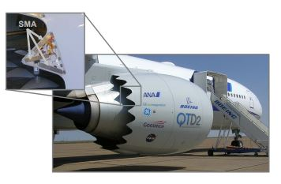
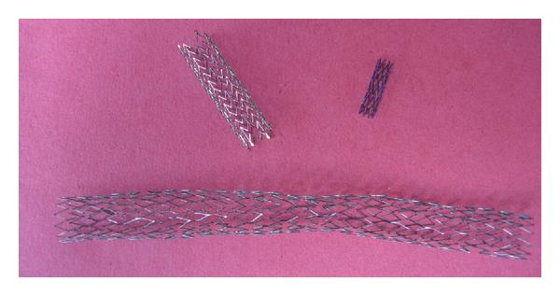
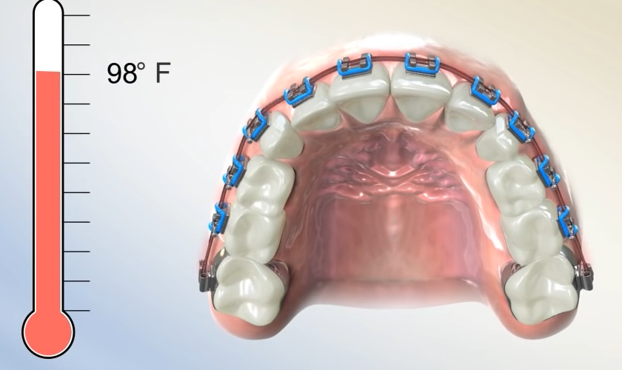
MECHANICAL ENGINEERING SCIENCE
ENGINEERING MATERIALS
SHAPE MEMORY ALLOYS
Materials exhibiting shape memory effect –
NiTiNOL (Nickel Titanium alloy developed at the Naval Ordinance Lab)
Cu-Al-Ni, Cu-Zn-Al, Au-Cd, Mn-Cu and Ni-Mn-Ga
Applications –
Medical field – braces, stents etc.
Actuation systems – Aerospace (Actuation systems in jet engines, variable
geometry chevron)
Automotive (Chevrolette Corvett SMA actuator)

Slide 28
MECHANICAL ENGINEERING SCIENCE
ENGINEERING MATERIALS
RHEOLOGICAL FLUIDS
A special class of fluids exists that change their rheological properties on the application of an electric or a magnetic field.
These controllable fluids can in general be grouped under one of two categories: electrorheological (ER) fluids and magnetorheological (MR) fluids.
An electric field causes a change in the viscosity of ER fluids, and a magnetic field causes a similar change in MR fluids. The change in viscosity can be used in a variety of applications.
Composition - Both ER and MR fluids consist of a colloidal suspension of particles in a carrier fluid. In the case of ER fluids, the particles are micron-sized dielectric particles, and could be corn starch or some alumino-silicate compound. The carrier fluid is electrically non-conducting, and could be mineral oil, silicone oil or paraffin oil. In the case of MR fluids, the properties of the carrier fluid are similar to those of ER fluids. However, the particles must be some ferromagnetic material.

Slide 29
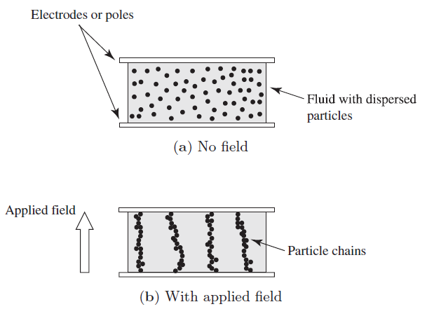
MECHANICAL ENGINEERING SCIENCE
ENGINEERING MATERIALS
RHEOLOGICAL FLUIDS
In the case of an ER/MR fluid, when an electric/magnetic field is applied, the particles become polarized and attract each other. As a result, chains of particles form in the fluid between the electrodes.
In the absence of a field, the fluid can freely flow across the electrodes in response to an applied pressure gradient, or can be sheared by a relative motion of the electrodes.
On the application of the field, the fluid flow across the electrodes is impeded by the particle chains. A larger pressure gradient is required to break the chains and maintain the flow of the fluid. As a result, a larger force is required on the electrodes to produce a relative motion between them.
The forming and breaking of the chains results in a significant change in the viscosity of the fluid.

Slide 30
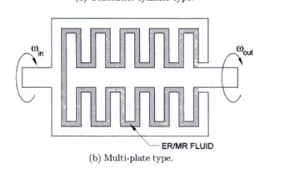
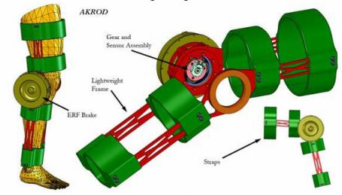
MECHANICAL ENGINEERING SCIENCE
ENGINEERING MATERIALS
RHEOLOGICAL FLUIDS
Applications –
controllable dampers,
clutches,
suspension shock absorbers,
valves,
brakes,
prosthetic devices,
traversing mechanisms,
torque transfer devices,
engine mounts and robotic arms.

Slide 31
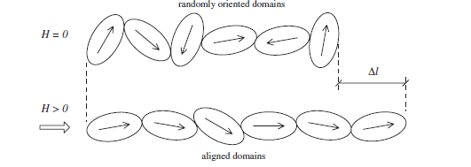
MECHANICAL ENGINEERING SCIENCE
ENGINEERING MATERIALS
MAGNETOSTRICTIVE MATERIAL
Magnetostrictives are active materials that exhibit magneto mechanical coupling.
The materials undergo a change in dimensions in response to an applied magnetic field. The induced strain depends only on the magnitude of the applied field, and is independent of its polarity.
Example for magnetostricitve material – Terfenol – D (Ter for Terbium, Fe for Ferrous, NOL for Naval Ordnance Laboratory, and D for Dysprosium)

Slide 32
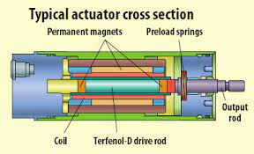
MECHANICAL ENGINEERING SCIENCE
ENGINEERING MATERIALS
MAGNETOSTRICTIVE MATERIAL
Applications –
Sensors
Actuators - Low frequency, high power sonar applications
Motion generation against external loads
Ultrasonic applications

Slide 33
MECHANICAL ENGINEERING SCIENCE
Chapter 2 – Stress and Strain
Srinivasa Prasad K S
Department of Mechanical Engineering

Slide 34
MECHANICAL ENGINEERING SCIENCE
STRESS AND STRAIN
INTRODUCTION TO MECHANICS OF MATERIALS
Mechanics of materials is a branch of applied mechanics that deals with the behavior of solid bodies subjected to various types of loading. Other names for this field of study are strength of materials and mechanics of deformable bodies.
The principal objective of mechanics of materials is to determine the stresses, strains, and displacements in structures and their components due to the loads acting on them. If we can find these quantities for all values of the loads up to the loads that cause failure, we will have a complete picture of the mechanical behavior of these structures.
An understanding of mechanical behavior is essential for the safe design of all types of structures, whether airplanes and antennas, buildings and bridges, machines and motors, or ships and spacecraft. That is why mechanics of materials is a basic subject in so many engineering fields.

Slide 35

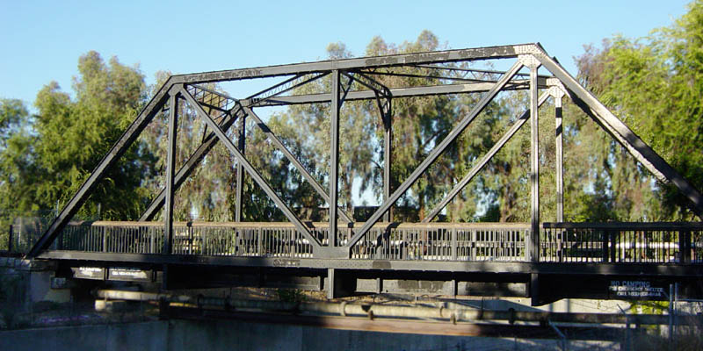
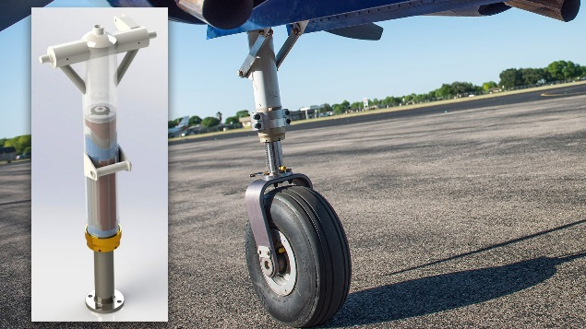
MECHANICAL ENGINEERING SCIENCE
STRESS AND STRAIN
NORMAL STRESS AND STRAIN
The most fundamental concepts in mechanics of materials are stress and strain. These concepts can be illustrated in their most elementary form by considering a prismatic bar subjected to axial forces.
A prismatic bar is a straight structural member having the same cross section throughout its length, and an axial force is a load directed along the axis of the member, resulting in either tension or compression in the bar.
Examples are the tow bar, a prismatic member in tension; the landing gear strut, a member in compression; the members of a bridge truss, wing struts in small airplanes etc.

Slide 36
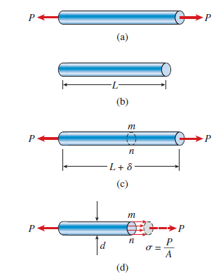
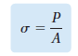
MECHANICAL ENGINEERING SCIENCE
STRESS AND STRAIN
NORMAL STRESS AND STRAIN
Consider a bar subjected to equal and opposite tensile forces of magnitude P.
The internal actions in the bar are exposed if we make an imaginary cut through the bar at section mn.
If we consider the equilibrium of either the left part or the right part at section mn, taken as a free body, we observe that the resultant of the internal resisting forces acting on the section must be equal to P and they may be assumed to be uniformly distributed over the whole area of the cross – section.
The average intensity of these distributed forces is equal to the force per unit area and is called stress denoted by the Greek letter σ.

Slide 37
MECHANICAL ENGINEERING SCIENCE
STRESS AND STRAIN
NORMAL STRESS AND STRAIN
When the bar is stretched by the forces P, the stresses are tensile stresses; if the forces are reversed in direction, causing the bar to be compressed, we obtain compressive stresses. Inasmuch as the stresses act in a direction perpendicular to the cut surface, they are called normal stresses. Thus, normal stresses may be either tensile or compressive.
When a sign convention for normal stresses is required, it is customary to define tensile stresses as positive and compressive stresses as negative.
Because the normal stress σ is obtained by dividing the axial force by the cross-sectional area, it has units of force per unit of area (N/m²).

Slide 38
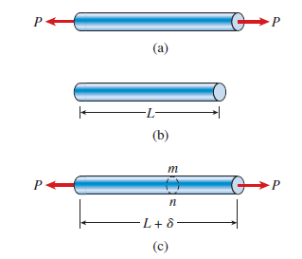
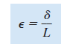
MECHANICAL ENGINEERING SCIENCE
STRESS AND STRAIN
NORMAL STRESS AND STRAIN
As already observed, a straight bar will change in length when loaded axially, becoming longer when in tension and shorter when in compression.
For instance, consider again the prismatic bar. The elongation δ of this bar is the cumulative result of the stretching of all elements of the material throughout the volume of the bar.
In general, the elongation of a segment is equal to its length divided by the total length L and multiplied by the total elongation δ. Therefore, a unit length of the bar will have an elongation equal to 1/L times δ.
This quantity is called the elongation per unit length, or strain, and is denoted by the Greek letter ε. We see that strain is given by the equation

Slide 39
MECHANICAL ENGINEERING SCIENCE
STRESS AND STRAIN
NORMAL STRESS AND STRAIN
If the bar is in tension, the strain is called a tensile strain, representing an elongation or stretching of the material.
If the bar is in compression, the strain is a compressive strain and the bar shortens.
Tensile strain is usually taken as positive and compressive strain as negative.
The strain ε is called a normal strain because it is associated with normal stresses.
Because normal strain is the ratio of two lengths, it is a dimensionless quantity, that is, it has no units.

Slide 40
MECHANICAL ENGINEERING SCIENCE
STRESS AND STRAIN
STRESS – STRAIN DIAGRAM
The design of machines and structures so that they will function properly requires that we understand the mechanical behavior of the materials being used.
Ordinarily, the only way to determine how materials behave when they are subjected to loads is to perform experiments in the laboratory.
The usual procedure is to place small specimens of the material in testing machines, apply the loads, and then measure the resulting deformations (such as changes in length and changes in diameter).
Most materials-testing laboratories are equipped with machines capable of loading specimens in a variety of ways, including both static and dynamic loading in tension and compression.

Slide 41
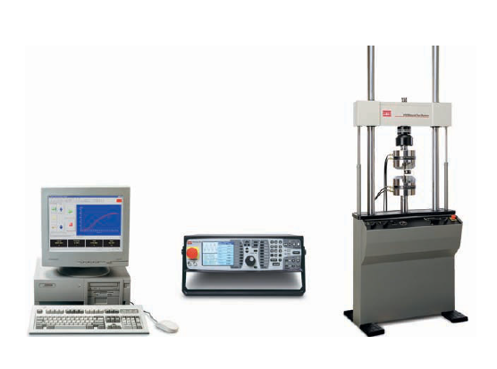
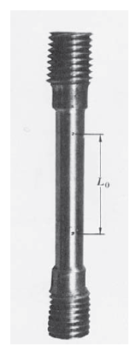
MECHANICAL ENGINEERING SCIENCE
STRESS AND STRAIN
STRESS – STRAIN DIAGRAM
A typical tensile-test machine is shown in Figure. The test specimen is installed between the two large grips of the testing machine and then loaded in tension.
Measuring devices record the deformations, and the automatic control and data-processing systems (at the left in the photo) tabulate and graph the results.
A more detailed view of a tensile-test specimen is shown in Figure. The ends of the circular specimen are enlarged where they fit in the grips so that failure will not occur near the grips themselves.

Slide 42
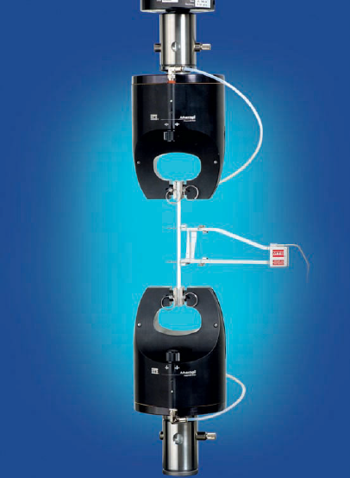
MECHANICAL ENGINEERING SCIENCE
STRESS AND STRAIN
STRESS – STRAIN DIAGRAM
The device at the left, which is attached by two arms to the specimen, is an extensometer that measures the elongation during loading.
In order that test results will be comparable, the dimensions of test specimens and the methods of applying loads must be standardized.
One of the major standards organizations in the United States is the American Society for Testing and Materials (ASTM), a technical society that publishes specifications and standards for materials and testing.
The ASTM standard tension specimen has a diameter of 0.505 in. and a gage length of 2.0 in. between the gage marks, which are the points where the extensometer arms are attached to the specimen.

Slide 43
MECHANICAL ENGINEERING SCIENCE
STRESS AND STRAIN
STRESS – STRAIN DIAGRAM
As the specimen is pulled, the axial load is measured and recorded, either automatically or by reading from a dial.
The elongation over the gage length is measured simultaneously.
In a static test, the load is applied slowly and the precise rate of loading is not of interest because it does not affect the behavior of the specimen.
After performing a tension or compression test and determining the stress and strain at various magnitudes of the load, we can plot a diagram of stress versus strain.
Such a stress-strain diagram is a characteristic of the particular material being tested and conveys important information about the mechanical properties and type of behavior.

Slide 44
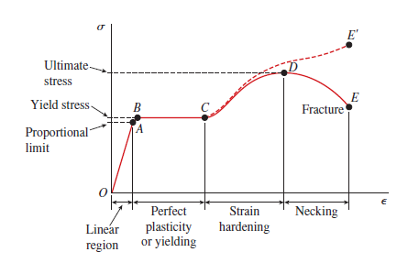
MECHANICAL ENGINEERING SCIENCE
STRESS AND STRAIN
STRESS – STRAIN DIAGRAM OF MILD STEEL
The first material we will discuss is structural steel, also known as mild steel or low-carbon steel.
A stress-strain diagram for a typical structural steel in tension is shown in Figure.

Slide 45
MECHANICAL ENGINEERING SCIENCE
STRESS AND STRAIN
STRESS – STRAIN DIAGRAM OF MILD STEEL
The diagram begins with a straight line from the origin O to point A, which means that the relationship between stress and strain in this initial region is not only linear but also proportional.
Beyond point A, the proportionality between stress and strain no longer exists; hence the stress at A is called the proportional limit.
For low-carbon steels, this limit is in the range (210 to 350 MPa), but high-strength steels (with higher carbon content plus other alloys) can have proportional limits of more than 550 MPa.
The slope of the straight line from O to A is called the modulus of elasticity.

Slide 46
MECHANICAL ENGINEERING SCIENCE
STRESS AND STRAIN
STRESS – STRAIN DIAGRAM OF MILD STEEL
With an increase in stress beyond the proportional limit, the strain begins to increase more rapidly for each increment in stress.
Consequently, the stress-strain curve has a smaller and smaller slope, until, at point B, the curve becomes horizontal.
Beginning at this point, considerable elongation of the test specimen occurs with no noticeable increase in the tensile force (from B to C). This phenomenon is known as yielding of the material, and point B is called the yield point. The corresponding stress is known as the yield stress of the steel.
In the region from B to C , the material becomes perfectly plastic, which means that it deforms without an increase in the applied load.

Slide 47
MECHANICAL ENGINEERING SCIENCE
STRESS AND STRAIN
STRESS – STRAIN DIAGRAM OF MILD STEEL
After undergoing the large strains that occur during yielding in the region BC, the steel begins to strain harden.
During strain hardening, the material undergoes changes in its crystalline structure, resulting in increased resistance of the material to further deformation.
Elongation of the test specimen in this region requires an increase in the tensile load, and therefore the stress-strain diagram has a positive slope from C to D.
The load eventually reaches its maximum value, and the corresponding stress (at point D) is called the ultimate stress.
Further stretching of the bar is actually accompanied by a reduction in the load, and fracture finally occurs at a point such as E.

Slide 48
MECHANICAL ENGINEERING SCIENCE
STRESS AND STRAIN
STRESS – STRAIN DIAGRAM OF MILD STEEL
When a test specimen is stretched, lateral contraction occurs, as previously mentioned.
The resulting decrease in cross-sectional area is too small to have a noticeable effect on the calculated values of the stresses up to about point C.
In the vicinity of the ultimate stress, the reduction in area of the bar becomes clearly visible and a pronounced necking of the bar occurs.
Fracture finally occurs at a point such as E.

Slide 49
MECHANICAL ENGINEERING SCIENCE
STRESS AND STRAIN
STRESS – STRAIN DIAGRAM OF MILD STEEL
The axial stress σ in a test specimen is calculated by dividing the axial load P by the cross-sectional area A.
When the initial area of the specimen is used in the calculation, the stress is called the nominal stress (other names are conventional stress and engineering stress).
A more exact value of the axial stress, called the true stress, can be calculated by using the actual area of the bar at the cross section where failure occurs. Since the actual area in a tension test is always less than the initial area, the true stress is larger than the nominal stress.
The average axial strain ε in the test specimen is found by dividing the measured elongation δ between the gage marks by the gage length L.
If the initial gage length is used in the calculation then the nominal strain is obtained. Since the distance between the gage marks increases as the tensile load is applied, we can calculate the true strain (or natural strain) at any value of the load by using the actual distance between the gage marks. In tension, true strain is always smaller than nominal strain.

Slide 50
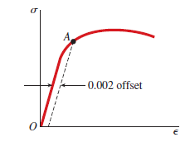
MECHANICAL ENGINEERING SCIENCE
STRESS AND STRAIN
STRESS – STRAIN DIAGRAM OF OTHER MATERIALS
The presence of a clearly defined yield point followed by large plastic strains is an important characteristic of structural steel that is sometimes utilized in practical design.
Metals such as structural steel that undergo large permanent strains before failure are classified as ductile. Other materials that behave in a ductile manner (under certain conditions) include aluminum, copper, magnesium, lead, molybdenum, nickel, brass, bronze, monel metal, nylon, and teflon.
Although they may have considerable ductility, aluminum alloys typically do not have a clearly definable yield point, as shown by the stress-strain diagram of Figure.

Slide 51
MECHANICAL ENGINEERING SCIENCE
STRESS AND STRAIN
STRESS – STRAIN DIAGRAM OF OTHER MATERIALS
When a material such as aluminum does not have an obvious yield point and yet undergoes large strains after the proportional limit is exceeded, an arbitrary yield stress may be determined by the offset method.
A straight line is drawn on the stress-strain diagram parallel to the initial linear part of the curve but offset by some standard strain, such as 0.002 (or 0.2%). The intersection of the offset line and the stress-strain curve (point A in the figure) defines the yield stress.
Because this stress is determined by an arbitrary rule and is not an inherent physical property of the material, it should be distinguished from a true yield stress by referring to it as the offset yield stress.

Slide 52
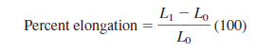
MECHANICAL ENGINEERING SCIENCE
STRESS AND STRAIN
MEASURES OF DUCTILITY
The ductility of a material in tension can be characterized by its elongation and by the reduction in area at the cross section where fracture occurs.
The percent elongation is defined as follows:
in which L₀ is the original gage length and L₁ is the distance between the gage marks at fracture.
Because the elongation is not uniform over the length of the specimen but is concentrated in the region of necking, the percent elongation depends upon the gage length. Therefore, when stating the percent elongation, the gage length should always be given. For a 2 in. gage length, steel may have an elongation in the range from 3% to 40%, depending upon composition.

Slide 53
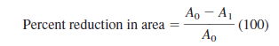
MECHANICAL ENGINEERING SCIENCE
STRESS AND STRAIN
MEASURES OF DUCTILITY
The percent reduction in area measures the amount of necking that occurs and is defined as follows
in which A0 is the original cross-sectional area and A1 is the final area at the fracture section. For ductile steels, the reduction is about 50%.

Slide 54
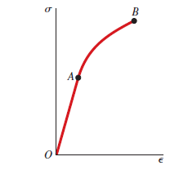
MECHANICAL ENGINEERING SCIENCE
STRESS AND STRAIN
STRESS- STRAIN DIAGRAM OF A BRITTLE MATERIAL
Materials that fail in tension at relatively low values of strain are classified as brittle. Examples are concrete, stone, cast iron, glass, ceramics, and a variety of metallic alloys.
Brittle materials fail with only little elongation after the proportional limit is exceeded. Furthermore, the reduction in area is insignificant, and so the nominal fracture stress (point B) is the same as the true ultimate stress.

Slide 55
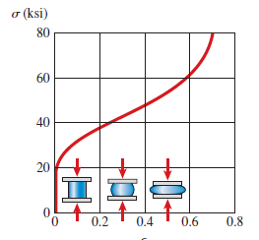
MECHANICAL ENGINEERING SCIENCE
STRESS AND STRAIN
STRESS- STRAIN DIAGRAM IN COMPRESSION
Stress-strain curves for materials in compression differ from those in tension.
Ductile metals such as steel, aluminum, and copper have proportional limits in compression very close to those in tension, and the initial regions of their compressive and tensile stress-strain diagrams are about the same.
However, after yielding begins, the behavior is quite different.
In a tension test, the specimen is stretched, necking may occur, and fracture ultimately takes place. When the material is compressed, it bulges outward on the sides and becomes barrel shaped, because friction between the specimen and the end plates prevents lateral expansion.

Slide 56
MECHANICAL ENGINEERING SCIENCE
STRESS AND STRAIN
STRESS- STRAIN DIAGRAM IN COMPRESSION
With increasing load, the specimen is flattened out and offers greatly increased resistance to further shortening (which means that the stress-strain curve becomes very steep.
Brittle materials loaded in compression typically have an initial linear region followed by a region in which the shortening increases at a slightly higher rate than does the load.
The stress-strain curves for compression and tension often have similar shapes, but the ultimate stresses in compression are much higher than those in tension.
Also, unlike ductile materials, which flatten out when compressed, brittle materials actually break at the maximum load.

Slide 57
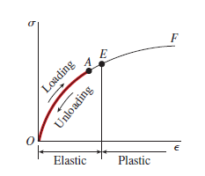
MECHANICAL ENGINEERING SCIENCE
STRESS AND STRAIN
ELASTICITY AND PLASTICITY
Stress-strain diagrams portray the behavior of engineering materials when the materials are loaded in tension or compression, as described in the preceding section. To go one step further, let us now consider what happens when the load is removed and the material is unloaded.
Assume, for instance, that we apply a load to a tensile specimen so that the stress and strain go from the origin O to point A on the stress strain curve.
Suppose further that when the load is removed, the material follows exactly the same curve back to the origin O. This property of a material, by which it returns to its original dimensions during unloading, is called elasticity, and the material itself is said to be elastic.
Note that the stress-strain curve from O to A need not be linear in order for the material to be elastic.

Slide 58

MECHANICAL ENGINEERING SCIENCE
STRESS AND STRAIN
ELASTICITY AND PLASTICITY
Now suppose that we load this same material to a higher level, so that point B is reached on the stress-strain curve.
When unloading occurs from point B, the material follows line BC on the diagram. This unloading line is parallel to the initial portion of the loading curve; that is, line BC is parallel to a tangent to the stress-strain curve at the origin.
When point C is reached, the load has been entirely removed, but a residual strain, or permanent strain, represented by line OC, remains in the material. As a consequence, the bar being tested is longer than it was before loading. This residual elongation of the bar is called the permanent set.
Of the total strain OD developed during loading from O to B, the strain CD has been recovered elastically and the strain OC remains as a permanent strain. Thus, during unloading the bar returns partially to its original shape, and so the material is said to be partially elastic.

Slide 59
MECHANICAL ENGINEERING SCIENCE
STRESS AND STRAIN
ELASTICITY AND PLASTICITY
Between points A and B on the stress-strain curve, there must be a point before which the material is elastic and beyond which the material is partially elastic.
To find this point, we load the material to some selected value of stress and then remove the load. If there is no permanent set (that is, if the elongation of the bar returns to zero), then the material is fully elastic up to the selected value of the stress.
The process of loading and unloading can be repeated for successively higher values of stress. Eventually, a stress will be reached such that not all the strain is recovered during unloading.
By this procedure, it is possible to determine the stress at the upper limit of the elastic region, for instance, the stress at point E. The stress at this point is known as the elastic limit of the material.
The characteristic of a material by which it undergoes inelastic strains beyond the strain at the elastic limit is known as plasticity.

Slide 60

MECHANICAL ENGINEERING SCIENCE
STRESS AND STRAIN
LINEAR ELASTICITY AND HOOKE’S LAW
Many structural materials, including most metals, wood, plastics, and ceramics, behave both elastically and linearly when first loaded. Consequently, their stress-strain curves begin with a straight line passing through the origin.
When a material behaves elastically and also exhibits a linear relationship between stress and strain, it is said to be linearly elastic.
The linear relationship between stress and strain for a bar in simple tension or compression is expressed by the equation
in which σ is the axial stress, ε is the axial strain, and E is a constant of
proportionality known as the modulus of elasticity for the material.

Slide 61
MECHANICAL ENGINEERING SCIENCE
STRESS AND STRAIN
LINEAR ELASTICITY AND HOOKE’S LAW
The equation σ = Eε is commonly known as Hooke’s law, named for the famous English scientist Robert Hooke (1635–1703).
The modulus of elasticity has relatively large values for materials that are very stiff, such as structural metals.
Steel has a modulus of approximately 210 GPa; for aluminum, values around 73 GPa) are typical.
More flexible materials have a lower modulus—values for plastics range from 0.7 to 14 GPa.
For most materials, the value of E in compression is nearly the same as in tension.

Slide 62




MECHANICAL ENGINEERING SCIENCE
STRESS AND STRAIN
DEFORMATIONS OF MEMBERS UNDER AXIAL LOADING
Consider a homogeneous rod BC of length L and uniform cross section of area A subjected to a centric axial load P.
If the resulting axial stress σ = P/A does not exceed the proportional limit of the material, Hooke’s law applies and
from which
Recalling that the strain ε = δ/L and substituting for ε

Slide 63

MECHANICAL ENGINEERING SCIENCE
STRESS AND STRAIN
DEFORMATIONS OF MEMBERS UNDER AXIAL LOADING
Equation above can be used only if the rod is homogeneous (constant E), has a uniform cross section of area A, and is loaded at its ends.
If the rod is loaded at other points, or consists of several portions of various cross sections and possibly of different materials, it must be divided into component parts that satisfy the required conditions for the application of above Eq.
Using the internal force Pi , length Li , cross sectional area Ai, and modulus of elasticity Ei , corresponding to part i, the deformation of the entire rod is

Slide 64
MECHANICAL ENGINEERING SCIENCE
STRESS AND STRAIN
NUMERICALS
1) A circular rod of 12 mm diameter was tested for tension. The total elongation on a 300 mm length was 0.22 mm under a tensile load of 17 kN. Determine the value of E.

Slide 65

MECHANICAL ENGINEERING SCIENCE
STRESS AND STRAIN
NUMERICALS
Solution:

Slide 66

MECHANICAL ENGINEERING SCIENCE
STRESS AND STRAIN
NUMERICALS
2) A member ABCD is subjected to point loads P1, P2, P3 and P4 as shown in figure below. Calculate the force P2 necessary for equilibrium if P1 = 10 kN, P3 = 40 kN and P4 = 16 kN. Taking modulus of elasticity as 2.05×10⁵ N/mm², determine the total elongation of the member.

Slide 67




MECHANICAL ENGINEERING SCIENCE
STRESS AND STRAIN
NUMERICALS
Solution:

Slide 68

MECHANICAL ENGINEERING SCIENCE
STRESS AND STRAIN
NUMERICALS
Solution:

Slide 69

MECHANICAL ENGINEERING SCIENCE
STRESS AND STRAIN
NUMERICALS
3) Two solid cylindrical rods AB and BC are welded together at B and loaded as shown. Determine the magnitude of the force P for which the tensile stress in rod AB has the same magnitude as the compressive stress in rod BC.

Slide 70

MECHANICAL ENGINEERING SCIENCE
STRESS AND STRAIN
NUMERICALS
Solution:

Slide 71

MECHANICAL ENGINEERING SCIENCE
STRESS AND STRAIN
NUMERICALS
4) A member ABC is formed by connecting a steel bar of 20 mm diameter to an aluminium bar of 30 mm diameter and is subjected to forces as shown in figure below. Determine the total deformation of the bar, taking E for aluminium as 0.7×10⁵ N/mm² and that for steel as 2×10⁵ N/mm²

Slide 72


MECHANICAL ENGINEERING SCIENCE
STRESS AND STRAIN
NUMERICALS
Solution:

Slide 73

MECHANICAL ENGINEERING SCIENCE
STRESS AND STRAIN
NUMERICALS
5) A reinforced concrete column 450 mm×450 mm has four steel rods of 25 mm diameter embedded in it. Determine the stresses in steel and concrete when total load on the column is 1000 kN. Take moduli of elasticity for steel and concrete as 205 MPa and 13.6 N/mm² respectively.

Slide 74

MECHANICAL ENGINEERING SCIENCE
STRESS AND STRAIN
NUMERICALS

Slide 75

MECHANICAL ENGINEERING SCIENCE
STRESS AND STRAIN
NUMERICALS

Slide 76


MECHANICAL ENGINEERING SCIENCE
STRESS AND STRAIN
POISSON’S RATIO
When a prismatic bar is loaded in tension, the axial elongation is accompanied by lateral contraction (that is, contraction normal to the direction of the applied load).
The lateral strain ε’ at any point in a bar is proportional to the axial strain ε at that same point if the material is linearly elastic.
The ratio of these strains is a property of the material known as Poisson’s ratio.
This dimensionless ratio, usually denoted by the Greek letter ν (nu), can be expressed by the equation

Slide 77
MECHANICAL ENGINEERING SCIENCE
STRESS AND STRAIN
POISSON’S RATIO
The minus sign is inserted in the equation to compensate for the fact that the lateral and axial strains normally have opposite signs.
Poisson’s ratio lies in the range 0.25 to 0.35 for most metals and many other materials.
Materials with an extremely low value of Poisson’s ratio include cork, for which ν is practically zero, and concrete, for which ν is about 0.1 or 0.2.
A theoretical upper limit for Poisson’s ratio is 0.5. Rubber comes close to this limiting value.

Slide 78


MECHANICAL ENGINEERING SCIENCE
STRESS AND STRAIN
SHEAR STRESS AND SHEAR STRAIN
Consider the bolted connection shown in Figure. This connection consists of a flat bar A, a clevis C, and a bolt B that passes through holes in the bar and clevis.
Under the action of the tensile loads P, the bar and clevis tend to shear the bolt, that is, cut through it.

Slide 79


MECHANICAL ENGINEERING SCIENCE
STRESS AND STRAIN
SHEAR STRESS AND SHEAR STRAIN
The free-body diagram of Figure shows that there is a tendency to shear the bolt along cross sections mn and pq. From a free-body diagram of the portion mnpq of the bolt, we see that shear forces V act over the cut surfaces of the bolt.
The shear forces V are the resultants of the shear stresses distributed over the cross-sectional area of the bolt. These stresses act parallel to the cut surface.
The average shear stress on the cross section of a bolt is obtained by dividing the total shear force V by the area A of the cross section on which it acts, as follows:

Slide 80

MECHANICAL ENGINEERING SCIENCE
STRESS AND STRAIN
SHEAR STRESS AND SHEAR STRAIN
Shear stresses acting on an element of material are accompanied by shear strains.
As an aid in visualizing these strains, we note that the shear stresses have no tendency to elongate or shorten the element in the x, y, and z directions—in other words, the lengths of the sides of the element do not change.
Instead, the shear stresses produce a change in the shape of the element. The original element, which is a rectangular parallelepiped, is deformed into an oblique parallelepiped, and the front and rear faces become rhomboids.

Slide 81
MECHANICAL ENGINEERING SCIENCE
STRESS AND STRAIN
SHEAR STRESS AND SHEAR STRAIN
Because of this deformation, the angles between the side faces change.
For instance, the angles at points q and s, which were π/2 before deformation, are reduced by a small angle γ to π/2 - γ.
At the same time, the angles at points p and r are increased to π/2+γ. The angle γ is a measure of the distortion, or change in shape, of the element and is called the shear strain.
Because shear strain is an angle, it is usually measured in degrees or radians.

Slide 82

MECHANICAL ENGINEERING SCIENCE
STRESS AND STRAIN
HOOKE’S LAW IN SHEAR
The properties of a material in shear can be determined experimentally from direct-shear tests or from torsion tests.
From the results of these tests, we can plot shear stress-strain diagrams (that is, diagrams of shear stress τ versus shear strain γ). These diagrams are similar in shape to tension-test diagrams (σ versus ε) for the same materials, although they differ in magnitudes.
For many materials, the initial part of the shear stress-strain diagram is a straight line through the origin, just as it is in tension. For this linearly elastic region, the shear stress and shear strain are proportional, and therefore we have the following equation for Hooke’s law in shear:
in which G is the shear modulus of elasticity (also called the modulus of rigidity).

Slide 83

MECHANICAL ENGINEERING SCIENCE
STRESS AND STRAIN
HOOKE’S LAW IN SHEAR
The moduli of elasticity in tension and shear are related by the following equation:

Slide 84


MECHANICAL ENGINEERING SCIENCE
STRESS AND STRAIN
FACTOR OF SAFETY
The maximum load that a structural member or a machine component will be allowed to carry under normal conditions is considerably smaller than the ultimate load.
This smaller load is called the allowable load or working or design load. Thus, only a fraction of the ultimate load capacity of the member is used when the allowable load is applied.
The remaining portion of the load-carrying capacity of the member is kept in reserve to assure its safe performance. The ratio of the ultimate load to the allowable load is used to define the factor of safety:
An alternative definition of the factor of safety is based on the use of stresses:

Slide 85

MECHANICAL ENGINEERING SCIENCE
STRESS AND STRAIN
NUMERICALS
5) A short hollow circular cast iron cylinder shown in Figure below is to support an axial compressive load of P = 500 kN. The ultimate stress in compression for the material is 240 N/mm². Determine the minimum required outside diameter d of the cylinder of 25 mm wall thickness, if the factor of safety is to be 3.0 with respect to ultimate strength.

Slide 86

MECHANICAL ENGINEERING SCIENCE
STRESS AND STRAIN
NUMERICALS
Solution:

Slide 87
MECHANICAL ENGINEERING SCIENCE
STRESS AND STRAIN
NUMERICALS
6) Two wooden planks, each 20 mm thick and 192 mm wide, are joined by the glued mortise joint shown. Knowing that the joint will fail when the average shearing stress in the glue reaches 800 KPa, determine the smallest allowable length d of the cut if the joint is to withstand an axial load of magnitude P = 6 KN

Slide 88

MECHANICAL ENGINEERING SCIENCE
STRESS AND STRAIN
NUMERICALS
Solution: Given t = 20 mm, P = 6 KN
From Fig., seven surfaces carry the applied axial load P = 6 KN = 6 $× {10}^{3}$ N
Area of each glue is A = dt
Shear stress $τ= \frac{P}{7A}$
$$A= \frac{P}{7τ}= \frac{6 × {10}^{3}}{7 × 800 × {10}^{3} }=1.0714 × {10}^{−3 } m^{2}$$
$A=$1.0714 $× {10}^{3} {mm}^{2}$
w.k.t
$d= \frac{A}{t}= \frac{1.0714 × {10}^{3}}{20}$
$d=53.57 mm$

Slide 89
MECHANICAL ENGINEERING SCIENCE
STRESS AND STRAIN
NUMERICALS
7) A bar of steel has rectangular cross – section 30 mm×20 mm. Determine the dimensions of the sides and percentage decrease of area of cross – section, when it is subjected to a tensile force of 120 kN in the direction of its length. Take E = 2×10⁵ N/mm² and ν = 0.3

Slide 90

MECHANICAL ENGINEERING SCIENCE
STRESS AND STRAIN
NUMERICALS
Solution:

Slide 91
MECHANICAL ENGINEERING SCIENCE
STRESS AND STRAIN
MECHANICAL PROPERTIES OF ENGINEERING MATERIALS
1) Strength: Strength is defined as the ability of the material to resist, without rupture, external forces causing various types of stresses.
Depending upon the type of stresses induced by external loads, strength is expressed as tensile strength, compressive strength or shear strength. The terms yield strength and ultimate strength have been explained previously.
2) Elasticity: Elasticity is defined as the ability of the material to regain its original shape and size after the deformation, when the external forces are removed.
3) Plasticity: Plasticity is defined as the ability of the material to retain the deformation produced under the load on a permanent basis.
4) Stiffness: Stiffness or rigidity is defined as the ability of the material to resist deformation under the action of an external load.

Slide 92

MECHANICAL ENGINEERING SCIENCE
STRESS AND STRAIN
MECHANICAL PROPERTIES OF ENGINEERING MATERIALS
5) Resilience: Resilience is defined as the ability of the material to absorb energy when deformed and to release this energy when loaded.
This property is essential for spring materials. It is measured by a quantity called modulus of resilience which is represented by the area under stress strain curve from the origin to the elastic limit.
6) Toughness: Toughness is defined as the ability of the material to absorb energy before fracture takes place.
This property is essential for machine components which are required to withstand impact loads. It is measured by a quantity called modulus of toughness. Modulus of toughness is the total area under stress – strain curve in a tension test.

Slide 93
MECHANICAL ENGINEERING SCIENCE
STRESS AND STRAIN
MECHANICAL PROPERTIES OF ENGINEERING MATERIALS
7) Malleability: Malleability is defined as the ability of a material to deform to a greater extent before the sign of crack, when it is subjected to compressive force.
8) Ductility: Ductility is defined as the ability of a material to deform to a greater extent before the sign of crack, when it is subjected to tensile force.
9) Brittleness: Brittleness is the property of a material which shows negligible plastic deformation before fracture takes place.

Slide 94
MECHANICAL ENGINEERING SCIENCE
STRESS AND STRAIN
MECHANICAL PROPERTIES OF ENGINEERING MATERIALS
10) Hardness: Hardness is defined as the resistance of the material to penetration.
It usually indicates resistance to abrasion, scratching, cutting or shaping. It is an important property in the selection of material for parts which rub on one another such as pinion and gear, cam and follower, rail and wheel and parts of a ball bearing. Wear resistance of these parts is improved by increasing surface hardness by case hardening.

Slide 95
MECHANICAL ENGINEERING SCIENCE
Chapter 3 – Power Transmission
Srinivasa Prasad K S
Department of Mechanical Engineering

Slide 96


MECHANICAL ENGINEERING SCIENCE
POWER TRANSMISSION
INTRODUCTION TO POWER TRANMISSION DRIVES
Power transmission drives are mainly used to transmit power from one shaft to another which rotate at the same speed or at different speeds.
There are two types of drives – rigid and flexible.
In flexible drives, there is an intermediate link such as belt, rope or chain between the driving and the driven shafts. Since the link is flexible, the drives are called ‘flexible’ drives.
The rotary motion of the driving shaft is first converted into translatory motion of the belt or chain and then again converted into rotary motion of the driven shaft.
In rigid drives like gear drives, there is direct contact between the driving and the driven shafts through the drive.
The rotary motion of the driving shaft is directly converted into rotary motion of the driven shaft.

Slide 97

MECHANICAL ENGINEERING SCIENCE
POWER TRANSMISSION
BELT DRIVES
Belts are used to transmit power between two shafts by means of friction.
A belt drive consists of three elements – driving and driven pulleys and an endless belt, which envelopes them. The belt is kept in tension so that motion of one pulley is transferred to the other without slip. It is used when the distance between the shafts is large.

Slide 98
MECHANICAL ENGINEERING SCIENCE
POWER TRANSMISSION
BELT DRIVES
Depending upon the shape of the cross – section, belts are classified as –
1) Flat belts
2) V belts
3) Round belts

Slide 99



MECHANICAL ENGINEERING SCIENCE
POWER TRANSMISSION
BELT DRIVES
Flat belts
These belts have rectangular cross section and the rim of the pulley is slightly crowned which helps to keep the belt running centrally on the pulley rim.

Slide 100


MECHANICAL ENGINEERING SCIENCE
POWER TRANSMISSION
BELT DRIVES
V - belts
V – belts have trapezoidal cross – section. A groove is made on the rim of the pulley of a V –belt drive to take the advantage of the wedge action.
Some advantages of V – belt are:
1) Positive drive as slip between belt and pulley is negligible
2) Higher power transmitting capacity
Some disadvantages of V – belt are:
1) Cannot be used for large centre distances
2) Costlier as compared to flat belts.

Slide 101


MECHANICAL ENGINEERING SCIENCE
POWER TRANSMISSION
BELT DRIVES
Round belts
There are certain applications where ‘round’ belts are used.
Round belts can operate satisfactorily over pulleys in several different planes. They are suitable for 90 degree twist, reverse bends or serpentine drives.
They can be stretched over the pulley and snapped into the groove very easily. This makes the assembly and replacement simple.
Round belts are limited to light duties. They are used in dishwasher drives, sewing machines, vacuum cleaners and light textile machinery.

Slide 102

MECHANICAL ENGINEERING SCIENCE
POWER TRANSMISSION
BELT DRIVES
Open belt drive
An open belt drive is used when the driven pulley is desired to be rotated in the same direction as the driving pulley.
While transmitting power, one side of the belt is more tightened known as ‘tight side’ as compared to the other known as ‘slack side’.
In case of horizontal drives, it is always desired that the tight side is at the lower side of the two pulleys. This is because the sag of the belt will be more on the upper side than the lower side. This slightly increases the angles of wrap of the belt on the two pulleys.

Slide 103

MECHANICAL ENGINEERING SCIENCE
POWER TRANSMISSION
BELT DRIVES
Crossed belt drive
A crossed belt drive is adopted when the drive pulley is to be rotated in the opposite direction to that of the driving pulley.
A crossed belt drive can transmit more power than the open belt drive as the angle of wrap is more. However, the belt has to bend in two different planes and it wears out more.

Slide 104

MECHANICAL ENGINEERING SCIENCE
POWER TRANSMISSION
TERMINOLOGIES OF BELT DRIVES
Velocity Ratio of belt drives
It is the ratio of the speed of the driven pulley to that of the driving pulley.
Let d₁ = Diameter of the driving pulley, d₂= Diameter of the driven pulley,
N₁= Speed of the driving pulley in rpm, and
N₂ = Speed of the driven pulley in rpm
Speed of the belt on driving pulley = πd₁N₁
Speed of the belt on driven pulley = πd₂N₂
Equating both of them, we get, Velocity Ratio = VR = $\frac{N_{2}}{N_{1}}=\frac{d_{1}}{d_{2}}$

Slide 105

MECHANICAL ENGINEERING SCIENCE
POWER TRANSMISSION
TERMINOLOGIES OF BELT DRIVES
Velocity Ratio of belt drives
When the thickness of the belt (t) is considered, then velocity ratio,

Slide 106

MECHANICAL ENGINEERING SCIENCE
POWER TRANSMISSION
TERMINOLOGIES OF BELT DRIVES
Slip of belt
When the frictional grip between the belt and the pulley becomes insufficient, it may cause some forward motion of the driving pulley without carrying the belt with it. This may also cause some forward motion of the belt without carrying the driven pulley with it. This is called slip of the belt and is generally expressed as a percentage.
The result of the belt slipping is to reduce the velocity ratio of the system.
Let s₁ = % Slip between the driving pulley and the belt, and s₂ = % Slip between the belt and the driven pulley.
Velocity ratio is then given by,
where s = s₁ + s₂, i.e. total percentage of slip

Slide 107


MECHANICAL ENGINEERING SCIENCE
POWER TRANSMISSION
TERMINOLOGIES OF BELT DRIVES
Length of an Open belt drive
Let r₁ and r₂ = Radii of the larger and smaller pulleys,
x = Distance between the centres of two pulleys (i.e. O₁O₂), and
L = Total length of the belt.
Length of the belt is given by,
L₀ = π (r₁ + r₂) + 2$x+ \frac{{{(r}_{1}− r_{2})}^{2}}{x}$

Slide 108


MECHANICAL ENGINEERING SCIENCE
POWER TRANSMISSION
TERMINOLOGIES OF BELT DRIVES
Length of a Crossed belt drive
Let r₁ and r₂ = Radii of the larger and smaller pulleys,
x = Distance between the centres of two pulleys (i.e. O₁O₂), and
L = Total length of the belt.
Length of the belt is given by,
L_{c} = π (r₁ + r₂) + 2$x+ \frac{{{(r}_{1}+ r_{2})}^{2}}{x}$

Slide 109


MECHANICAL ENGINEERING SCIENCE
POWER TRANSMISSION
TERMINOLOGIES OF BELT DRIVES
Ratio of Belt Tensions for a Flat Belt Drive
Let T₁ = Tension in the belt on the tight side,
T₂ = Tension in the belt on the slack side, and
θ = Angle of contact in radians
μ = coefficient of friction between the belt and
the pulley
The ratio belt tensions is given by,

Slide 110


MECHANICAL ENGINEERING SCIENCE
POWER TRANSMISSION
TERMINOLOGIES OF BELT DRIVES
Ratio of Belt Tensions for a V - Belt Drive
Let T₁ = Tension in the belt on the tight side,
T₂ = Tension in the belt on the slack side, and
θ = Angle of contact in radians
μ = coefficient of friction between the belt and
the pulley
α = semi grove angle
The ratio belt tensions is given by,

Slide 111
MECHANICAL ENGINEERING SCIENCE
POWER TRANSMISSION
TERMINOLOGIES OF BELT DRIVES
Ratio of Belt Tensions for a V - Belt Drive
The expression for ratio of belt tensions is similar to that for a flat belt drive except that μ is replaced by μ/sin α, i.e., the coefficient of friction is increased by 1/sin α.
Therefore, for identical materials of belt and pulleys, the coefficient of friction of V – belt is far greater than that of flat belt.
Consequently, the power transmitting capacity of V – belt is much more than that of flat belt. Therefore, V – belts are more powerful.
Due to increased frictional force, the slip is less in V – belt compared with flat belt.

Slide 112
MECHANICAL ENGINEERING SCIENCE
POWER TRANSMISSION
TERMINOLOGIES OF BELT DRIVES
Power Transmitted
Let T₁ = Tension in the belt on the tight side,
T₂ = Tension in the belt on the slack side
v = linear velocity of the belt = (π×d×N)/60 in m/s
P = Power transmitted
Then, P = Net force × Distance moved/second
P = (T₁ – T₂) ×V watts

Slide 113



MECHANICAL ENGINEERING SCIENCE
POWER TRANSMISSION
TERMINOLOGIES OF BELT DRIVES
Determination of Angle of Contact
When the two pulleys of different diameters are connected by means of an open belt as shown in Fig., then the angle of contact or lap (θ) at the smaller pulley must be taken into consideration.
Let r₁ and r₂ = Radii of the larger and smaller pulleys,
x = Distance between the centres of two pulleys (i.e. O₁O₂)
From Figure,
Angle of contact or lap,

Slide 114



MECHANICAL ENGINEERING SCIENCE
POWER TRANSMISSION
TERMINOLOGIES OF BELT DRIVES
Determination of Angle of Contact
A little consideration will show that when the two pulleys are connected by means of a crossed belt as shown in Fig., then the angle of contact or lap (θ) on both the pulleys is same.
Let r₁ and r₂ = Radii of the larger and smaller pulleys,
x = Distance between the centres of two pulleys (i.e. O₁O₂)
From figure,
Angle of contact or lap

Slide 115
MECHANICAL ENGINEERING SCIENCE
POWER TRANSMISSION
NUMERICALS
A shaft runs at 80 rpm and drives another shaft at 150 rpm through belt drive. The diameter of the driving pulley is 600 mm. Determine the diameter of the driven pulley in the following cases:
(i) Neglecting belt thickness
(ii) Taking belt thickness as 5 mm
(iii) Assuming for case (ii) a total slip of 4%

Slide 116

MECHANICAL ENGINEERING SCIENCE
POWER TRANSMISSION
NUMERICALS
Solution:

Slide 117

MECHANICAL ENGINEERING SCIENCE
POWER TRANSMISSION
NUMERICALS
Solution:

Slide 118
MECHANICAL ENGINEERING SCIENCE
POWER TRANSMISSION
NUMERICALS
2) Two parallel shafts, connected by a crossed belt, are provided with pulleys 480 mm and 640 mm in diameters. The distance between the centre lines of the shafts is 3 m. Determine by how much the length of the belt should be changed if it is desired to alter the direction of rotation of the driven shaft.

Slide 119

MECHANICAL ENGINEERING SCIENCE
POWER TRANSMISSION
NUMERICALS
Solution:
Given: $d_{1 }=2 r_{1}=640 mm$ , $d_{2 }=2 r_{2}=480 mm$, $x=3000 mm$
$r_{1}=320 mm$, $r_{2}=240 mm$
Find: ${(L}_{c}−{ L}_{o})= ?$
For crossed belt
L_{c} = π (r₁ + r₂) + 2$x+ \frac{{{(r}_{1}+ r_{2})}^{2}}{x}$
L_{c} = π (320 + 240) + 2$(3000)+ \frac{{(320+240)}^{2}}{3000}$
L_{c} = 7863.83$mm$

Slide 120

MECHANICAL ENGINEERING SCIENCE
POWER TRANSMISSION
NUMERICALS
Solution:
For open belt
L₀ = π (r₁ + r₂) + 2$x+ \frac{{{(r}_{1}− r_{2})}^{2}}{x}$
L₀ = π (320 + 240) + 2$(3000)+ \frac{{(320 −240)}^{2}}{3000}$
L₀ = 7761.43$mm$
∴ Change in length of the belt = ${(L}_{c}−{ L}_{o})=(7863.83 −7761.43)=102.4 mm$
∴ For open belt shorten the belt by 102.4$mm$

Slide 121
MECHANICAL ENGINEERING SCIENCE
POWER TRANSMISSION
NUMERICALS
3) A casting weighs 6 kN and is freely suspended from a rope which makes 2.5 turns round a drum of 200 mm diameter. If the drum rotates at 40 rpm, determine the force required by a man to pull the rope from the other end of the rope. Also, determine the power to raise the casting. The coefficient of friction is 0.25.

Slide 122

MECHANICAL ENGINEERING SCIENCE
POWER TRANSMISSION
NUMERICALS

Slide 123
MECHANICAL ENGINEERING SCIENCE
POWER TRANSMISSION
NUMERICALS
4) Two pulleys mounted on two parallel shafts that are 2 m apart are connected by a crossed belt drive. The diameters of the two pulleys are 500 mm and 240 mm. Determine the power transmitted if the larger pulley rotates at 180 rpm and the maximum permissible tension in the belt is 900 N. The coefficient of friction between the belt and pulley is 0.28

Slide 124

MECHANICAL ENGINEERING SCIENCE
POWER TRANSMISSION
NUMERICALS
Solution:
Angle of contact
$θ=180+2α$
Where $α=\sin^{−1}\left[\frac{(r_{1}+ r_{2})}{x}\right]=\sin^{−1}\left[\frac{(250+120)}{2000}\right]=10.7$°
∴ $θ=180+2× 10.7 = 201.4$° $θ=201.4 ×\frac{π}{180}=3.51 rad$

Slide 125

MECHANICAL ENGINEERING SCIENCE
POWER TRANSMISSION
NUMERICALS
Solution:
w.k.t $\frac{T_{1}}{T_{2}}= e^{μθ}$ or T₁ = T₂$e^{μθ}$
900 = T₂$e^{0.28×3.51}$ 900 = 2.67 T₂
Therefore T₂ = 337 N
Power transmitted
$V= \frac{πd_{1}N_{1}}{60}= \frac{π×0.5×180}{60}=4.71 \frac{m}{s}$
P = (T₁ -T₂) V = (900 – 337) $×$4.71
= 2651.73 W
or $P=2.65 kW$

Slide 126
MECHANICAL ENGINEERING SCIENCE
POWER TRANSMISSION
NUMERICALS
5) A belt drive transmits 5 kW of power between two parallel shafts. The distance between the shaft centers is 1.5 m and the diameter of the smaller pulley (driven pulley) is 440 mm. The driving and the driven shafts rotate at 60 rpm and 150 rpm respectively. The coefficient of friction is 0.22. Determine the tension in tight side of the belt if the two pulleys are connected by (i) open belt drive (ii) crossed belt drive.

Slide 127

MECHANICAL ENGINEERING SCIENCE
POWER TRANSMISSION
NUMERICALS
Solution:
We have, velocity of the belt given by,
$$v=\frac{πd_{2}N_{2}}{60}=\frac{π×440×{10}^{−3}×150}{60}=3.46 m/s$$
We know that, power transmitted is given by,
$$P=\left(T_{1}−T_{2}\right)v$$
Substituting P =5000 W, v = 3.46 m/s, we get,
$$5000=\left(T_{1}−T_{2}\right)3.46$$
$\left(T_{1}−T_{2}\right)=1445.09$---------(1)
a) Open belt drive
We have, angle of contact on the smaller pulley of the open belt drive given by,
$$θ=180−2\sin^{−1}\left(\frac{r_{1}−r_{2}}{x}\right)=180−2\sin^{−1}\left(\frac{550−220}{1500}\right)=154.58 degrees or 2.7 radians$$

Slide 128

MECHANICAL ENGINEERING SCIENCE
POWER TRANSMISSION
NUMERICALS
Solution:
We have,
$$\frac{T_{1}}{T_{2}}=e^{μθ}$$
$\frac{T_{1}}{T_{2}}=e^{0.22×2.7}=1.81$---------(2)
Using (1) and (2), we get T₁ = 3229.15 N
a) Crossed belt drive
We have, angle of contact in case of crossed belt drive given by,
$$θ=180+2\sin^{−1}\left(\frac{r_{1}+r_{2}}{x}\right)=180+2\sin^{−1}\left(\frac{550+220}{1500}\right)=241.77 degrees or 4.22 radians$$

Slide 129

MECHANICAL ENGINEERING SCIENCE
POWER TRANSMISSION
NUMERICALS
Solution:
We have,
$$\frac{T_{1}}{T_{2}}=e^{μθ}$$
$\frac{T_{1}}{T_{2}}=e^{0.22×4.22}=2.53$---------(2)
Using (1) and (2), we get T₁ = 2389.6 N

Slide 130
MECHANICAL ENGINEERING SCIENCE
POWER TRANSMISSION
ADVANTAGES OF BELT DRIVES
Belt drives offer the following advantages compared with other types of drives:
(i) Belt drives can transmit power over considerable distance between the axes of driving and driven shafts.
(ii) The operation of belt drive is smooth and silent.
(iii) They can transmit only a definite load, which if exceeded, will cause the belt to slip over the pulley, thus protecting the parts of the drive against overload.
(iv) They have the ability to absorb the shocks and damp vibration.
(v) They are simple to design.
(vi) They have low initial cost.

Slide 131
MECHANICAL ENGINEERING SCIENCE
POWER TRANSMISSION
DISADVANTAGES OF BELT DRIVES
The disadvantages of belt drives compared to other types of drives are as follows:
(i) Belt drives have large dimensions and occupy more space.
(ii) The velocity ratio is not constant due to belt slip.
(iii) They impose heavy loads on shafts and bearings.
(iv) There is considerable loss of power resulting in low efficiency.
(v) Belt drives have comparatively short service life.

Slide 132




MECHANICAL ENGINEERING SCIENCE
POWER TRANSMISSION
APPLICATIONS OF BELT DRIVES
Electric motors
Automobiles
Machine tools
Conveyors

Slide 133

MECHANICAL ENGINEERING SCIENCE
POWER TRANSMISSION
GEAR DRIVES
Gears are defined as toothed wheels which transmit power and motion from one shaft to another by means of successive engagement of teeth.
Gear drives offer the following advantages compared with chain or belt drives:
(i) It is a positive drive and the velocity ratio remains constant.
(ii) The centre distance between the shafts is relatively small, which results in
compact construction.
(iii) It can transmit very large power, which is beyond the range of belt or
chain drives.
(iv) It can transmit motion at very low velocity, which is not possible with the
belt drives.
(v) A provision can be made in the gearbox for gear shifting, thus changing
the velocity ratio over a wide range.

Slide 134

MECHANICAL ENGINEERING SCIENCE
POWER TRANSMISSION
GEAR DRIVES
Gears can be classified according to the relative positions of their shaft axes as follows:

Slide 135

MECHANICAL ENGINEERING SCIENCE
POWER TRANSMISSION
GEAR DRIVES
Gears can be classified according to the relative positions of their shaft axes as follows:

Slide 136
MECHANICAL ENGINEERING SCIENCE
POWER TRANSMISSION
GEAR DRIVES
Gears can be classified according to the relative positions of their shaft axes as follows:
1) Parallel Shafts
a) Spur Gears
b) Helical Gears
c) Double helical or Herringbone Gears

Slide 137


MECHANICAL ENGINEERING SCIENCE
POWER TRANSMISSION
GEAR DRIVES
Spur Gears
They have straight teeth parallel to the axes.
At the time of engagement of the two gears, the contact extends across the entire width on a line parallel to the axes of rotation. This results in sudden application of the load, high impact stresses and excessive noise at high speeds.
If the gears have external teeth on the outer surface of the cylinders, the shafts rotate in the opposite direction.
In an internal spur gear, the teeth are formed on the inner surface of an annulus ring. An internal gear can mesh with an external pinion (smaller gear) only and the two shafts rotate in the same direction.

Slide 138


MECHANICAL ENGINEERING SCIENCE
POWER TRANSMISSION
GEAR DRIVES
Helical Gears
In helical gears, the teeth are curved, each being helical in shape.
Two mating gears have the same helix angle, but have teeth of opposite hands.
At the begining of engagement, contact occurs only at the point of leading edge of the curved teeth. As the gears rotate, the contact extends along a diagonal line across the teeth.
Thus, the load application is gradual which results in low impact stresses and reduction in noise. Therefore, helical gears can be used at higher velocities than the spur gears and have greater load carrying capacity.
Helical gears have the disadvantage of having end thrust as there is a force component along the gear axis.

Slide 139



MECHANICAL ENGINEERING SCIENCE
POWER TRANSMISSION
GEAR DRIVES
Double - helical and Herringbone Gears
A double helical gear is equivalent to a pair of helical gears secured together, one having a right hand helix and the other a left – hand helix.
The teeth of the two rows are separated by a groove. Axial thrust which occurs in case of a single helical gears is eliminated in double helical gears. This is because the axial thrust of the two rows of teeth cancel each other out. These can be run at high speeds with less noise and vibrations.
If the left and the right inclinations of a double helical gear meet at a common apex and there is no groove in between, the gear is known as herringbone gear.

Slide 140
MECHANICAL ENGINEERING SCIENCE
POWER TRANSMISSION
GEAR DRIVES
2) Intersecting Shafts
a) Straight Bevel Gears
b) Spiral Bevel Gears

Slide 141


MECHANICAL ENGINEERING SCIENCE
POWER TRANSMISSION
GEAR DRIVES
Straight Bevel Gears
The teeth are straight, radial to the point of intersection of the shaft axes and vary in cross section throughout their length.
Usually they are used to connect shafts at right angles which run at lower speeds. Gears of same size and connecting two shafts at right angles to each other are known as mitre gears.

Slide 142

MECHANICAL ENGINEERING SCIENCE
POWER TRANSMISSION
GEAR DRIVES
Spiral Bevel Gears
When the teeth of a bevel gear are inclined at an angle to the face of the bevel, they are known as spiral bevels or helical bevels.
They are smoother in action and quieter than straight tooth bevels as there is gradual load application and low impact stresses. Of course, there exists an axial thrust calling for stronger bearings and supporting assemblies.
These are used for the drive to the differential of an automobile.

Slide 143
MECHANICAL ENGINEERING SCIENCE
POWER TRANSMISSION
GEAR DRIVES
2) Skew Shafts (Neither parallel nor intersecting)
a) Hypoid Gears
b) Worm Gears

Slide 144


MECHANICAL ENGINEERING SCIENCE
POWER TRANSMISSION
GEAR DRIVES
Hypoid Gears
Hypoid gears are a type of spiral bevel gears, with the difference that hypoid gears have axes that are non-intersecting and not parallel.
In other words, the axes of hypoid gears are offset from one another. The basic geometry of the hypoid gear is hyperbolic, rather than having the conical geometry of a spiral bevel gear.
The most common application for hypoid gearboxes is in the automotive industry, where they are used in rear axles, especially for large trucks. With a left-hand spiral angle on the pinion and a right-hand spiral angle on the crown, these applications have what is known as a “below-center” offset, which allows the driveshaft to be located lower in the vehicle.

Slide 145


MECHANICAL ENGINEERING SCIENCE
POWER TRANSMISSION
GEAR DRIVES
Worm Gears
The worm gears consist of a worm and a worm wheel.
The worm is in the form of a threaded screw, which meshes with the matching wheel.
Worm gear drives are used for shafts, the axes of which do not intersect and are perpendicular to each other.
Worm gear drives are characterized by high speed reduction ratio.

Slide 146


MECHANICAL ENGINEERING SCIENCE
POWER TRANSMISSION
GEAR DRIVES
Spur Rack and Pinion
Spur rack is a special case of a spur gear where it is made of infinite diameter.
The spur rack and pinion combination converts rotary motion into translator motion, or vice versa.
Example – It is used in a lathe in which the rack transmits motion to the saddle.

Slide 147

MECHANICAL ENGINEERING SCIENCE
POWER TRANSMISSION
GEAR DRIVES
Gear Terminology

Slide 148

MECHANICAL ENGINEERING SCIENCE
POWER TRANSMISSION
GEAR DRIVES
Gear Terminology
Pitch cylinders – Pitch cylinders of a pair of gears in mesh are the imaginary friction cylinders, which by pure rolling together, transmit the same motion as the pair of gears.
Pitch circle – It is the circle corresponding to a section of the equivalent pitch cylinder by a plane normal to the wheel axis.
Pitch diameter – It is the diameter of the pitch circle.

Slide 149

MECHANICAL ENGINEERING SCIENCE
POWER TRANSMISSION
GEAR DRIVES
Gear Terminology
Pitch – It is defined as follows.
Circular Pitch – It is the distance measured along the circumference of the pitch circle from a point on one tooth to the corresponding point on the adjacent tooth.
where p = circular pitch; d = pitch diameter; T = number of teeth

Slide 150


MECHANICAL ENGINEERING SCIENCE
POWER TRANSMISSION
GEAR DRIVES
Gear Terminology
Pitch – It is defined as follows.
b) Diametral Pitch – It is the number of the teeth per unit length of the pitch circle diameter in inches.
It can be seen that
The term diametral pitch is not used in SI units.

Slide 151


MECHANICAL ENGINEERING SCIENCE
POWER TRANSMISSION
GEAR DRIVES
Gear Terminology
Pitch – It is defined as follows.
c) Module – It is the ratio of the pitch diameter to the number of teeth. The term is used in SI units in place of diametral pitch.
Also,
Pitch of two mating gears must be same.

Slide 152

MECHANICAL ENGINEERING SCIENCE
POWER TRANSMISSION
GEAR DRIVES
Gear Terminology
Velocity ratio – The velocity ratio is defined as the ratio of the angular velocity of the driven gear to the angular velocity of the driving gear.
Let d = pitch diameter, T = number of teeth, ω = angular velocity (rad/s), N = angular velocity
(rpm); Subscript 1 = driving gear (driver), Subscript 2 = driven gear (follower)

Slide 153
MECHANICAL ENGINEERING SCIENCE
POWER TRANSMISSION
GEAR DRIVES
Gear Trains
A gear train is a combination of gears used to transmit motion from one shaft to another.
It becomes necessary when it is required to obtain large speed reduction within a small space.
Main types of gear trains –
1) Simple gear train
2) Compound gear train
3) Reverted gear train
4) Planetary or epicyclic gear train

Slide 154


MECHANICAL ENGINEERING SCIENCE
POWER TRANSMISSION
GEAR DRIVES
Simple Gear Train
A series of gears, capable of receiving and transmitting motion from one gear to another is called a simple gear train.
In the simple gear train, the gear axes remain fixed relative to the frame and each gear is on a separate shaft.

Slide 155


MECHANICAL ENGINEERING SCIENCE
POWER TRANSMISSION
GEAR DRIVES
Simple Gear Train
Speed ratio of a gear train – It is the ratio of the speed of the driving to that of the driven shaft.
Let T = number of teeth on a gear; N = speed of gear in rpm

Slide 156

MECHANICAL ENGINEERING SCIENCE
POWER TRANSMISSION
GEAR DRIVES
Simple Gear Train
Speed ratio is given by,
Thus it is seen that the intermediate gears have no effect on the speed ratio and therefore they are known as idlers.

Slide 157


MECHANICAL ENGINEERING SCIENCE
POWER TRANSMISSION
GEAR DRIVES
Compound Gear Train
When a series of gears are connected in such a way that two or more gears rotate about an axis with the same angular velocity, its known as compound gear train.
In this type, some of the intermediate shafts, i.e., other than the input and the output shafts, carry more than one gear.

Slide 158


MECHANICAL ENGINEERING SCIENCE
POWER TRANSMISSION
GEAR DRIVES
Compound Gear Train

Slide 159

MECHANICAL ENGINEERING SCIENCE
POWER TRANSMISSION
GEAR DRIVES
Reverted Gear Train
If the axes of the first and the last wheels of a compound gear coincide, it is called a reverted gear train.
Such an arrangement is used in clocks and in simple lathes where back gear is used to give a slow speed to the chuck.

Slide 160

MECHANICAL ENGINEERING SCIENCE
POWER TRANSMISSION
GEAR DRIVES
Planetary or Epicyclic Gear Train
A gear train having a relative motion of axes is called a planetary or an epicyclic gear train.
In an epicyclic gear train, the axis of at least one of the gears also moves relative to the frame.
Usually the wheel that rolls outside is known as epicyclic wheel. The term epicyclic emerges from the fact that the wheel traces an epicyclic path.
Large speed reductions are possible with epicyclic gears and if the fixed wheel is annular, a more compact unit could be obtained. Important applications are in transmission, computing devices etc.

Slide 161
MECHANICAL ENGINEERING SCIENCE
POWER TRANSMISSION
GEAR DRIVES
Numericals
The following data relate to two meshing gears –
Velocity ratio – 1/3
Module = 4 mm
Centre distance = 200mm
Determine the number of teeth of both the gears.

Slide 162


MECHANICAL ENGINEERING SCIENCE
POWER TRANSMISSION
GEAR DRIVES
Numericals
Solution

Slide 163

MECHANICAL ENGINEERING SCIENCE
POWER TRANSMISSION
GEAR DRIVES
Numericals
2) A compound gear train shown in the figure consists of compound gears B – C and D – E. All gears are mounted on parallel shafts. The motor shaft rotating at 800 rpm is connected to the gear A. The number of teeth on gears A, B, C, D, E and F are 24, 56, 30, 80, 32 and 72 respectively. Determine the speed of the gear F.

Slide 164

MECHANICAL ENGINEERING SCIENCE
POWER TRANSMISSION
GEAR DRIVES
Numericals
Solution

Slide 165

MECHANICAL ENGINEERING SCIENCE
POWER TRANSMISSION
GEAR DRIVES
Numericals
3) A reverted gear train shown in the figure is used to provide a speed ratio of 10. The module of gears 1 and 2 is 3.2 mm and of gears 3 and 4 is 2 mm. Determine suitable numbers of teeth for each gear. No gear is to have less than 20 teeth. The centre distance between shafts is 160 mm.

Slide 166

MECHANICAL ENGINEERING SCIENCE
POWER TRANSMISSION
GEAR DRIVES
Numericals

Slide 167

MECHANICAL ENGINEERING SCIENCE
POWER TRANSMISSION
GEAR DRIVES
Numericals

